Slide 1
The Dualistic Life of
Day & Night
From The Sims and King’s Bounty : The Legend to The Tales of Brunel
Ni Hu
1201611

Slide 2
Blurring Genres / About the Game
Sim? Turn-based Strategy? Role-playing?
One game, two states
  Day: Life Simulation (Reality)
  Night: Role-playing with Turn-based Strategy Combat (Dream)
Intertwined / Interactive
Notes:
Game genres are blurring.
The Tales of Brunel is settled in a dualistic world.
Day: Life Simulation (Reality)
Night: Role-playing with Turn-based Strategy Combat (Dream) The characters’ spirit comes out of their bodies and then venture forth into the fantasy adventure
The two states/modes are intertwined and interactive. The player will experience relative consequences caused by his behaviors in both day and night time respectively.

Slide 3
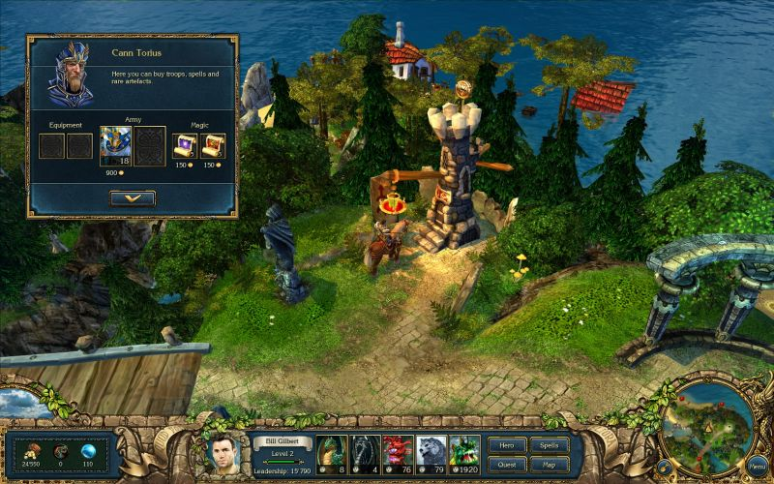
Aesthetics (from King's Bounty: The Legend)
A Contemporary Fantasy
Half-real Fantastic Graphics
Fantastic Orchestral Music
Notes:
Derived from King’s Bounty: The Legends
The story is a contemporary fantasy about a group of young people at Brunel standing against the plot of 2012.
Half-real and half-imaginary graphics
Well-orchestrated music in adventure and combat

Slide 4
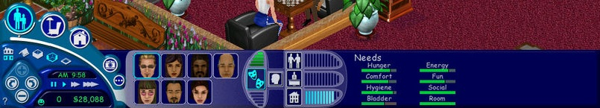
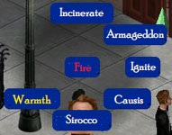
Interface (from The Sims)
Life and Adventure
Combat
Notes:
Control panel – every control and player status
Radial action menu in combat (can be applied to enemy and characters themselves)

Slide 5
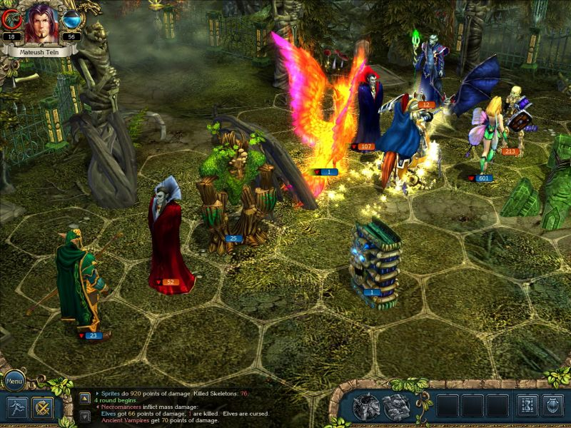
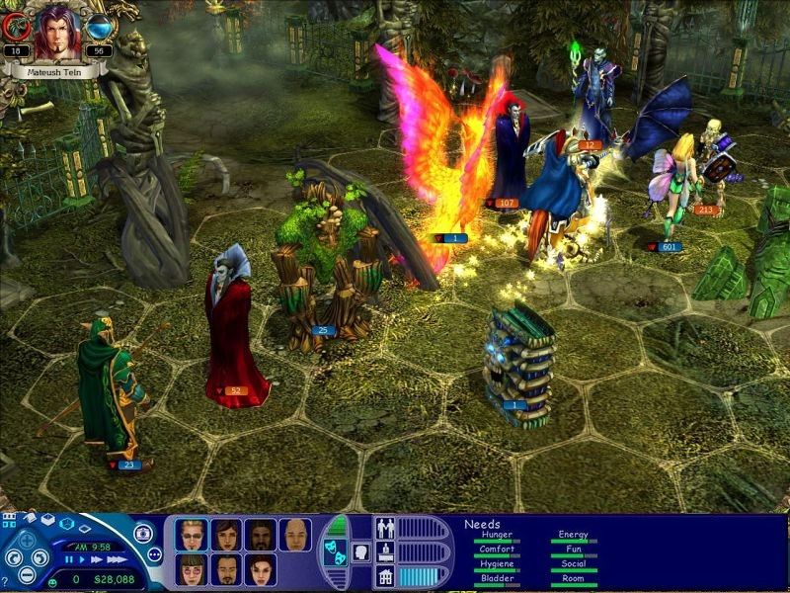
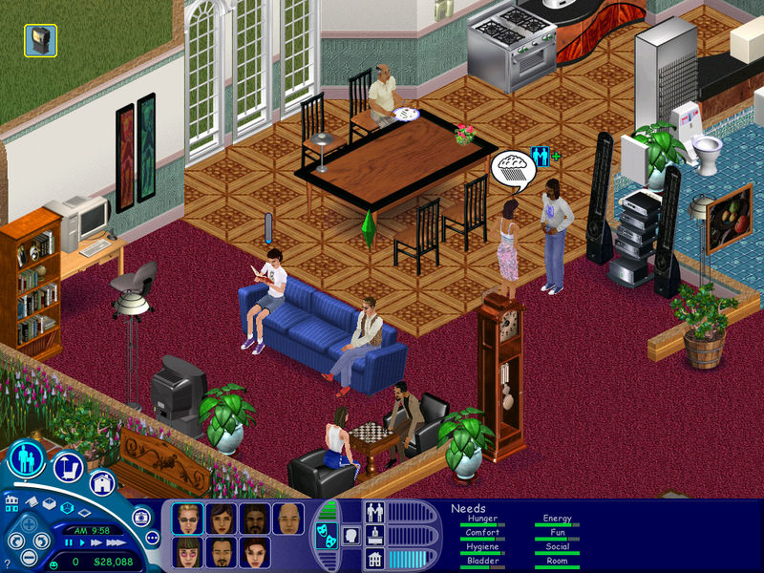
Avatar (from King's Bounty: The Legend)
Perspective
All-hero
Shift
Notes:
From a free overlooking view
In the whole game even in battles all units are heroes
The content in the UI changes between day and night, but the avatars the still in player’s control

Slide 6
Game Economics (from The Sims)
Day: Credits
Night: Amount determined by Credits
→#280
Notes:
Day: use credits
Night: Amount determined by Credits as one’s consumption level and view is influenced by the disposable income subconsciously

Slide 7
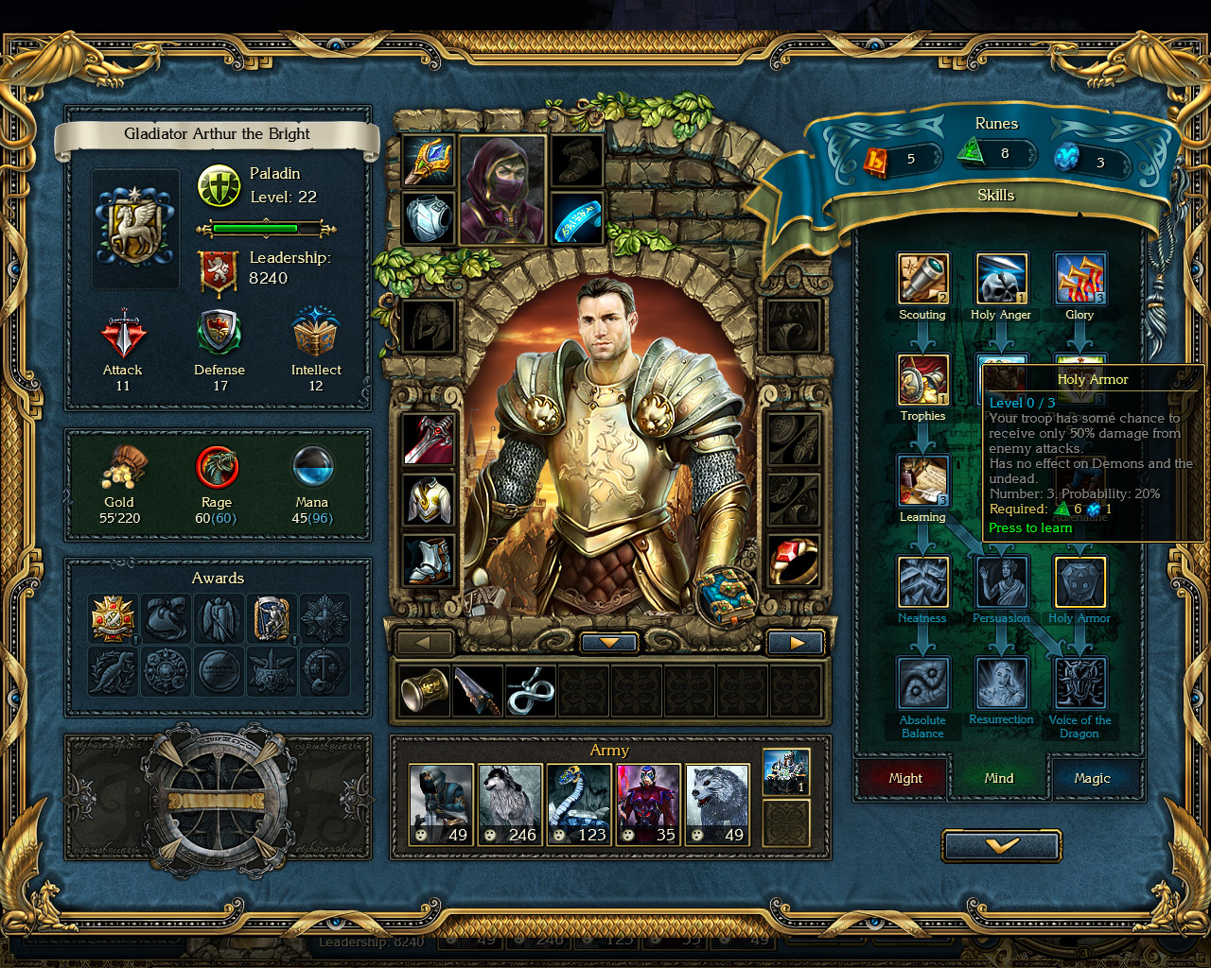
Cupcake (from King's Bounty: The Legend)
All you can expect from a RPG
In return increasing the Fun NEEDS
Notes:
Character developing, artifacts, feats, rewards…
The cupcake pleases the player and also the avatars he controls

Slide 8

Death (from The Sims)
No HP
Death is supposed to be REAL
Reality affects Dream
Dream reflects Reality
Notes:
In real life, normally death is caused by old age but this is not taken in to account because of the game’s time period
Two major factors in The Sims: Hunger and out of Energy
Reality affects Dream: e.g. if the character has low energy in the day time he/she won’t have good combat performance
Dream reflects Reality: e.g. in dream you die, you die in reality e.g. the cupcake

Slide 9
Chance (from King's Bounty: The Legend)
Use of random factors
Chance in adventure and battle (Night)
Apply to Life (Day)
Notes:
Use of random factors: random number based mechanics
Majorly Chance is applied to the game at night
But also has subtle effect on encounters in day time

Slide 10
Looking Forward
Blurring Genres
Idea: Grand Game
Notes:
Game of every game– everything

Slide 11
Thank you!
谢谢！

