Slide 1
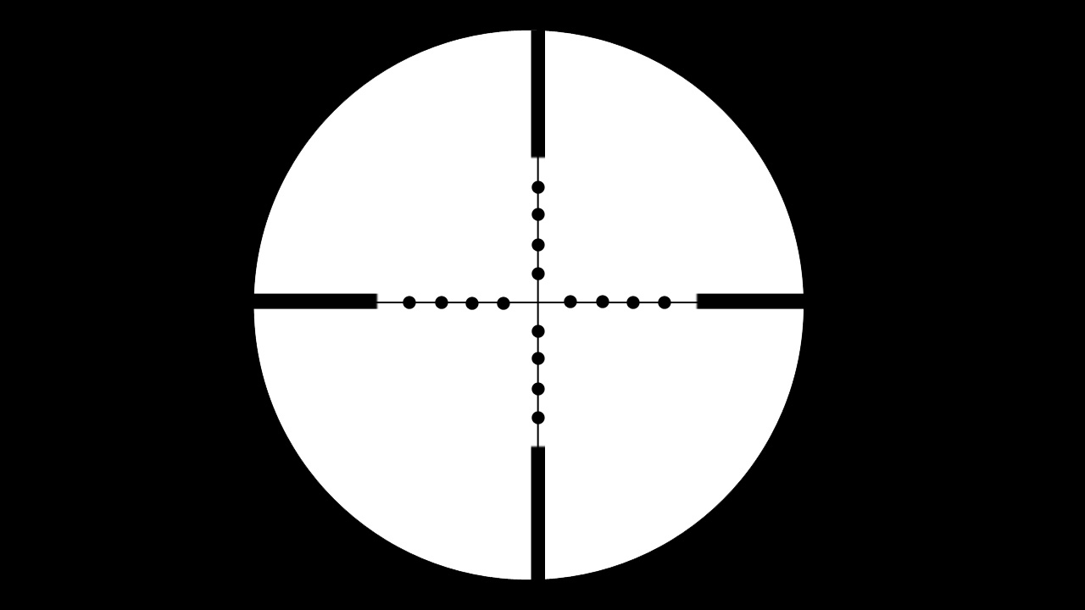
Seconds Count
Inspired by
JFK Reload
&
10 ^ 16 to 1
Ni Hu

Slide 2

The Pitch
High Concept
Target Market
Key Features
Presentation
Gameplay
Q & A

Slide 3
High Concept—Transformation
From JFK Reload, a
Historical Simulation “Game”
To Seconds Count, an
Alternative/Future History
Co-op/Competitive Action Game
Sci-Fi
10 ^ 16 to 1

Slide 4
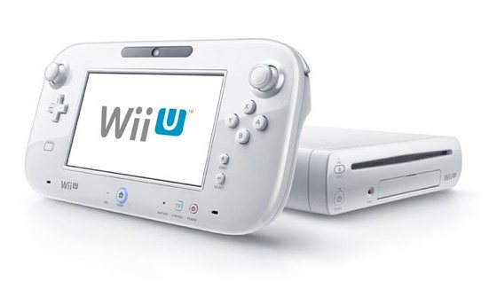
High Concept—Genre & Platform
Multiplayer First Person “Shooter”
Assassin Counter-Assassin
On
Cooperation
Competition

Slide 5
Target Market
Hardcore and Casual gamers mixed
Mid-core gamers

Slide 6
Key Features—Sci-Fi Settings
The motives of the assassinations:
Time crime? True justice?
Two rival factions:
The Assassins & The Time Defenders
Game: Operation Scenes of both real historical events and fictional history/future events

Slide 7
Key Features—Asymmetric Gameplay
 | The Assassins | The Time Defenders
Goal | To assassinate the target | To neutralise the assassination AND subdue the Assassin
Control | Wii U GamePad | Wii Remote / Nunchuk / Wii U Pro Controller

Slide 8





Key Features—Diverse Roles
The Assassins (1 player) | The Time Defenders (1-4 player(s))
Assassin (H) | Sensor (C)
 | Protector (C)
 | Interceptor (C)
 | Enforcer (H)
(H) More Hardcore Role
(C) More Casual Role
The absent roles will be filled by AI

Slide 9
Key Features—Seconds Count
Operation Window: in 5 seconds
Assassination Point
5s
Operation Window

Slide 10
Presentation—Graphics & Audio
Graphics: Cartoonish style to ease violence
Audio: Scene themed music and Sci-Fi sound effects

Slide 11

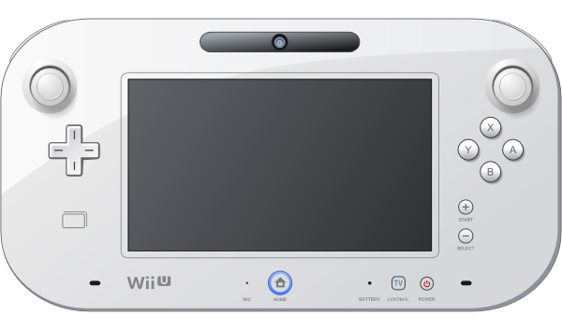
Presentation—GUI
Wii U GamePad & Split Screens on TV

Slide 12
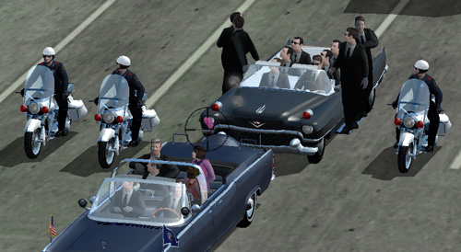
Gameplay—An Instance (Phase 1)
Two teams are invisible to each other and the world of the scene
The Assassin: 2-5 minutes to choose the assassination spot and get prepared
The Defenders: Get in defense positions before the Assassin pulls the trigger

Slide 13
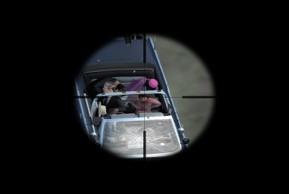
Gameplay—An Instance (Phase 2)
The Assassin acts: The Assassination Point (AP)
The Sensor automatically detects the action in advance by 5 seconds in the timeline.
Assassination Point
5s
Operation Window
0:5

Slide 14

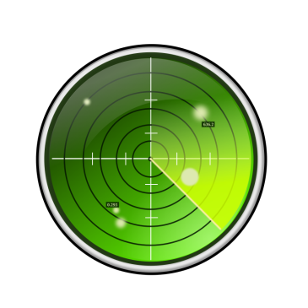
Gameplay—An Instance (Phase 3)
The Sensor: Identify the Assassin (make visible) and the attack; send signal to other team members (1s)
The Assassin: Evade (1s)
4s
1s
0:4

Slide 15




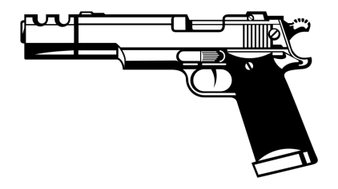
Gameplay—An Instance (Phase 4)
The Protector: Choose the right protection measures (mini games) and deploy them
The Interceptor: Intercept the incoming “bullet” (bullet time!)
The Enforcer: Try to apprehend or take down the Assassin (either before or after the AP)
4s
1s
0:4+1

Slide 16
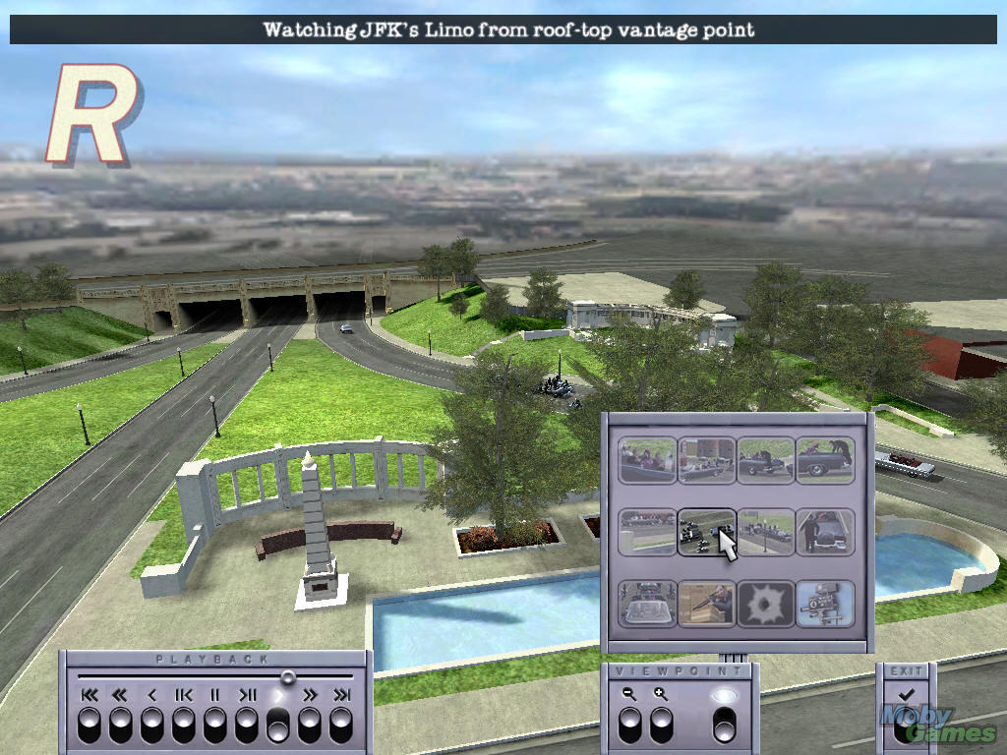
Gameplay—Time UP!
The operation scene ends when the Assassin successfully evades or is subdued
The Assassin wins: The target assassinated
The Time Defenders win: The assassination is neutralised AND the Assassin is subdued
Statistics & Replay of the operation
Score and Credits rewarded vary according to roles
Irrelevant actions (e.g. killing commoners) will lower Score and Credits
Credits can be spent on various equipment and items.
0:0

Slide 17
Q & A

Slide 18
Thank you
谢谢 ありがとう
Ni Hu

